Slide 1

Summer Training Presentation ON Website Development (Portfolio Website)
Submitted By:
Name : Hitesh Sharma
University RollNo : 181500272
GLA University
Mathura-281406 , India

Slide 2
INTRODUCTION
ESTABLISHMENT OF COMPANY:
Udemy, Inc. is an American online learning platform aimed at professional adults and students.
It was founded in May 2010 by Eren Bali, Gagan Biyani, and Oktay Caglar.
As of Jan 2020, the platform has more than 50 million students and 57,000 instructors teaching courses in over 65 languages.

Slide 3
OBJECTIVE OF TRAINING:
The main reason for selecting this web development course was that it is able to describe the structure and functionality of all coding required for front-end and back-end.
Also, the web development field is getting popular because it is always evolving and constantly changing.
It becomes interesting to work with new tools and learn new skills.

Slide 4
LANGUAGES:
Front-End web development :
HTML
CSS
BOOTSTRAP
Back-end web development :
PHP
TOOLS:
Windows 10
Google Chrome

Slide 5
TOOLS AND TECHNOLOGIES USED:
1. HTML : Hypertext Markup Language is the standard markup language for creating web pages and web application.
2. CSS : CSS is cascading style sheet which is used to give designer look to HTML using the external file.
3. BOOTSTRAP : Bootstrap is a potent front-end framework used to create modern websites and web apps.
4. PHP : Hypertext Preprocessor is a server-side scripting language designed for web development but also used as a general-purpose programming language.

Slide 6

What is Portfolio site:
A portfolio site is an extension of a freelancer's (or company's) résumé. It provides a convenient way for potential clients to view your work while also allowing you to expand on your skills and services.

Slide 7
FEATURES OF WEBSITE:
Home Page
About Page
Resume Page
Portfolio Page
Services Page
Contact Page

Slide 8
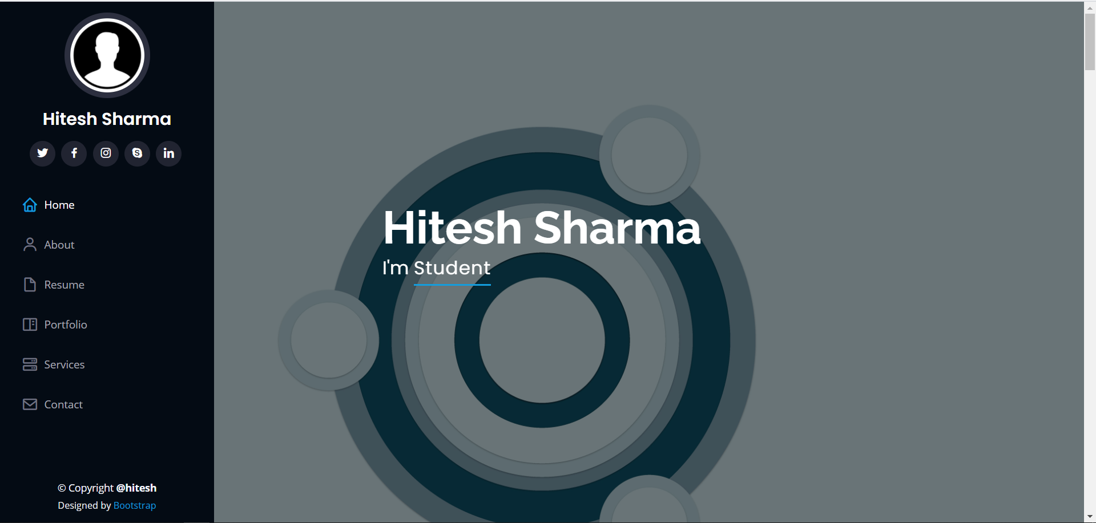
HOME PAGE:

Slide 9
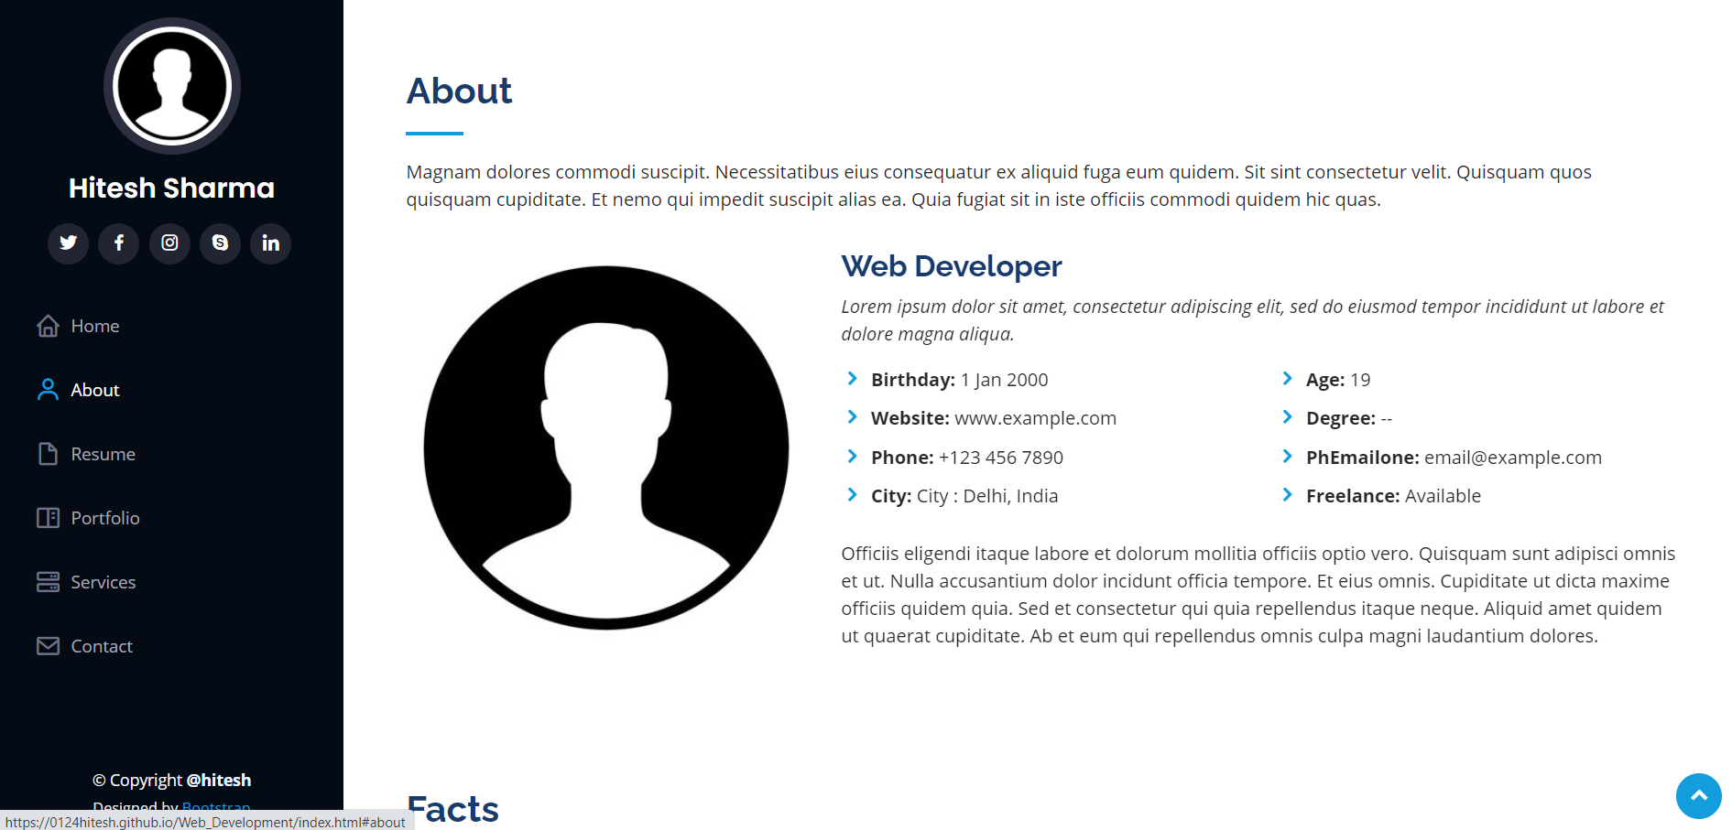
ABOUT PAGE:

Slide 10
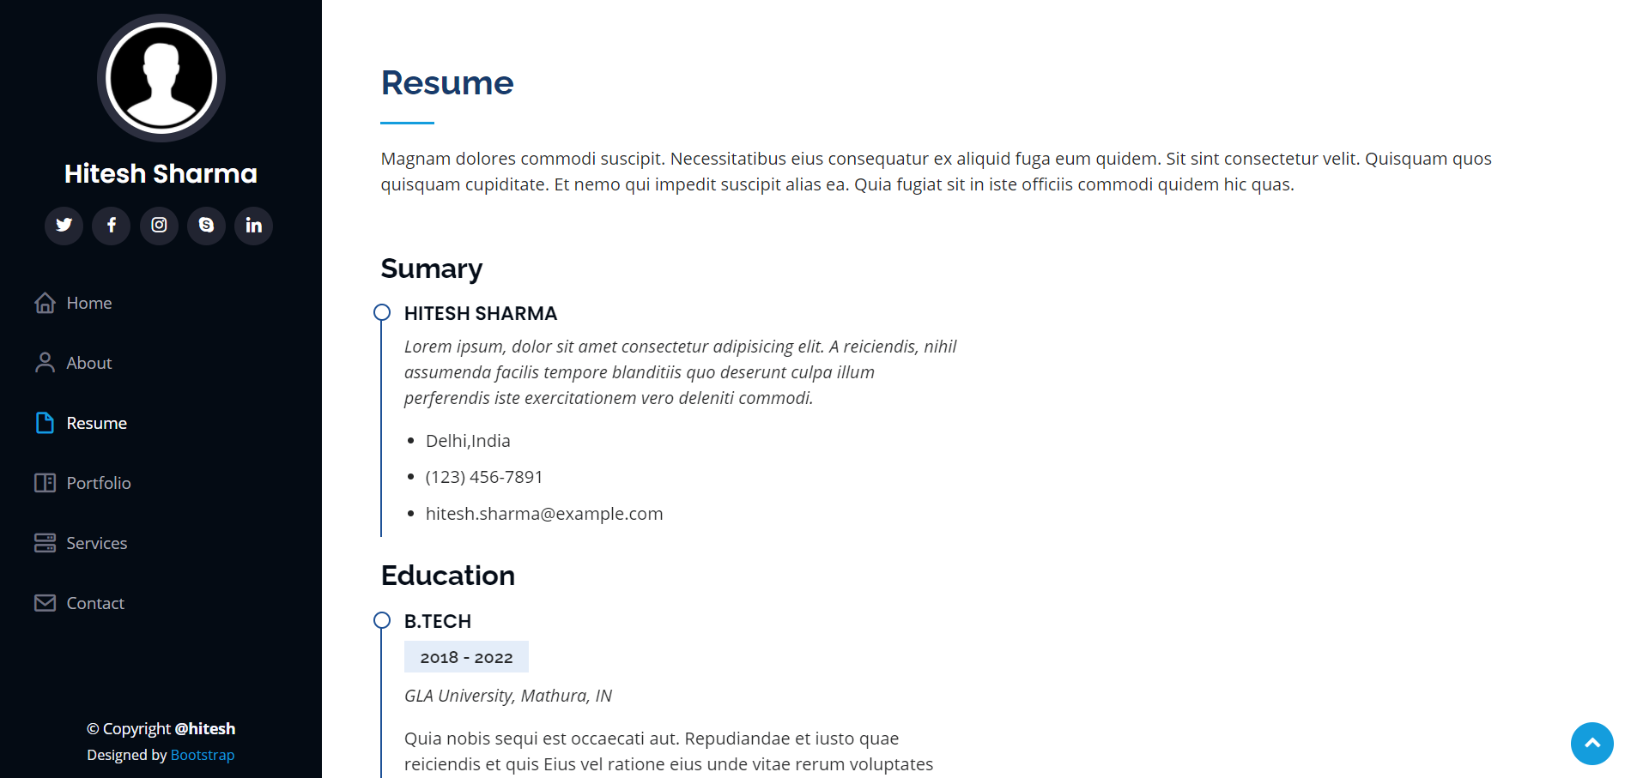
RESUME PAGE:

Slide 11
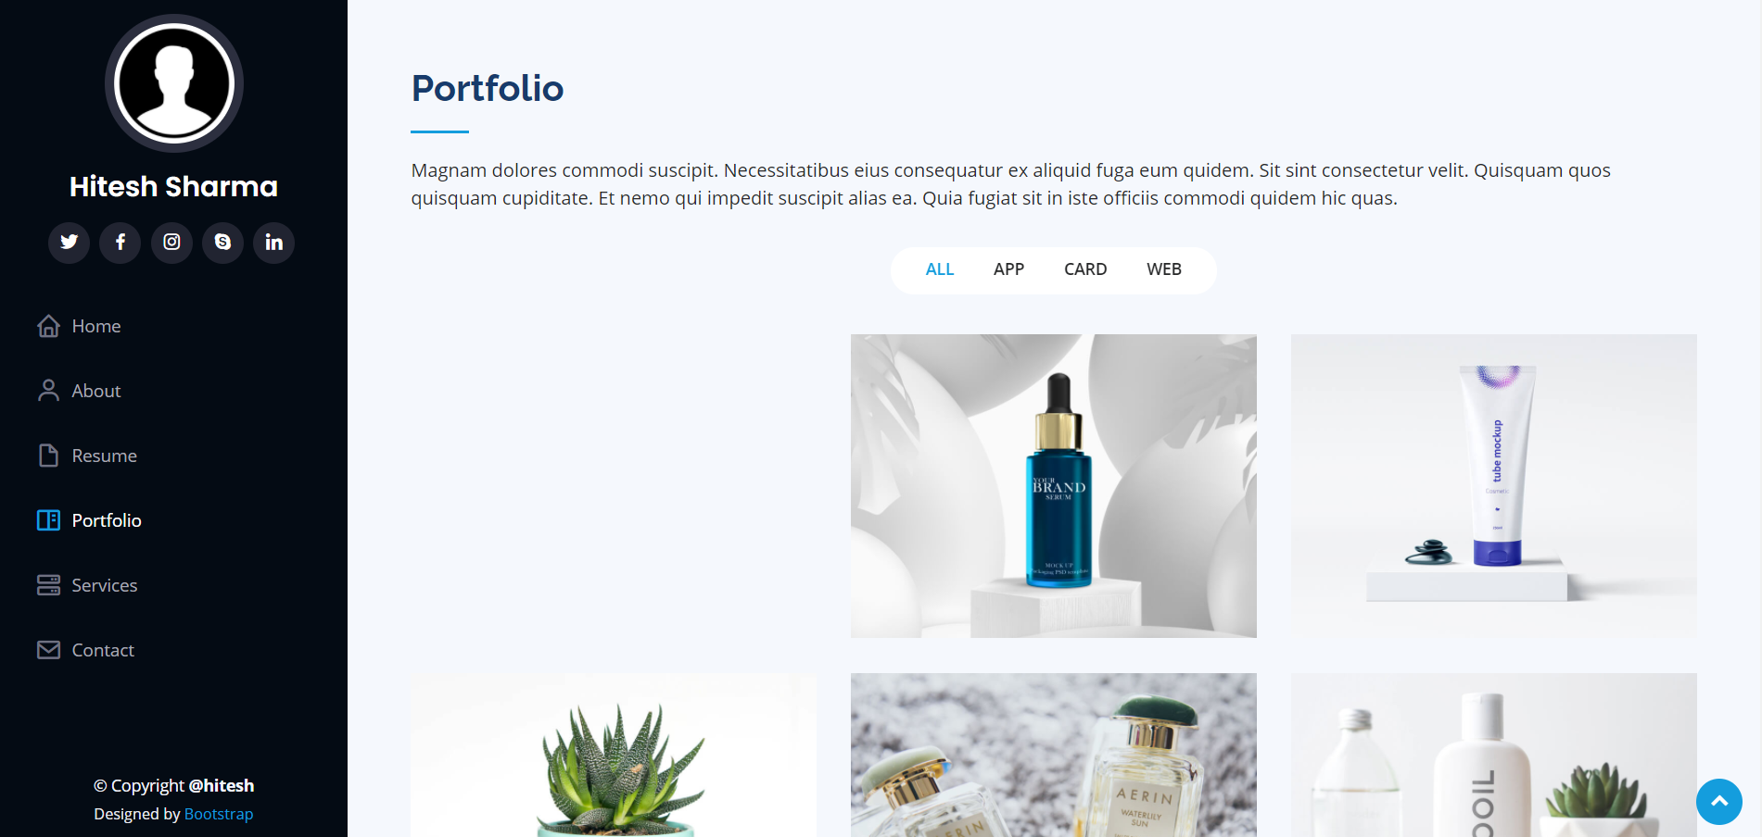
PORTFOLIO PAGE:

Slide 12
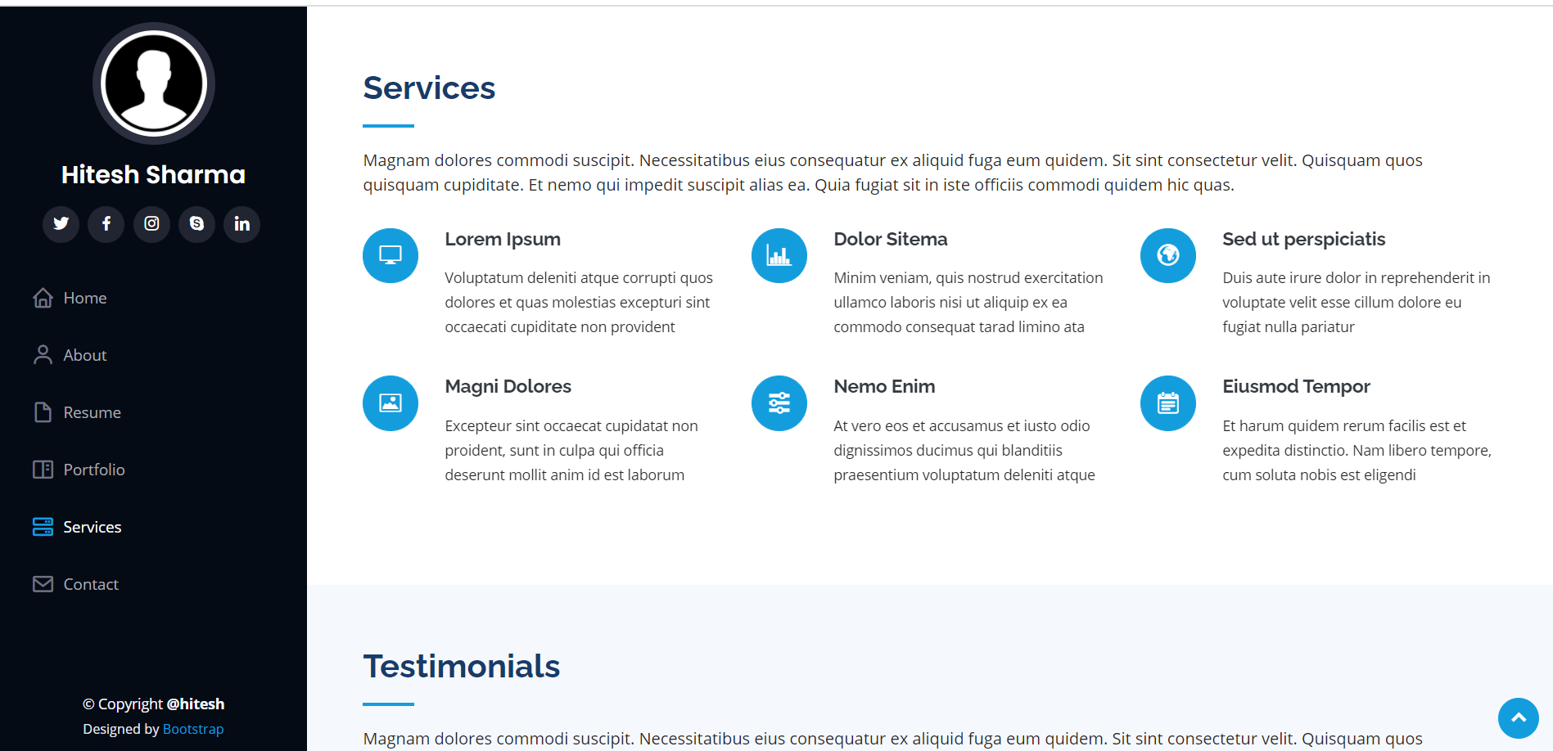
SERVICES PAGE:

Slide 13
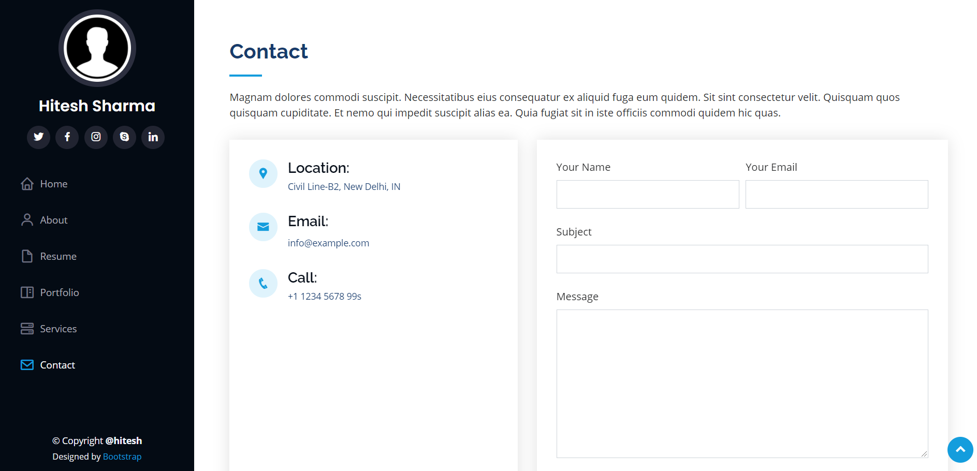
CONTACT PAGE:

Slide 14
CONCLUSION
The above implementation resulted in a basic portfolio website which is compilation of material that exemplifies user skills, qualification, education.
The project is a classic example, that learning of concepts needs to be supplemented with application of that knowledge, without which knowledge remains incomplete.

Slide 15
LIMITATIONS
One of the most important limitations was the time period. Due to limited duration of this course, some of the topics weren’t studied in detail.
It doesn’t actually consider all the points that are required in real for a website.
Message option in contact section is not a part of this website.

Slide 16
EXPERIENCE
It was quite interesting to see the things appearing on the front-end of the website with several validation codes running at the back-end.
Although I found it a bit challenging but exploring this domain was equally amazing.
The experience of working on Udemy was nice too.

Slide 17
BIBLIOGRAPHY
The coding part was implemented majorly with the help of Udemy training course only. https://udemy.com/
Other links referred were : https://www.w3schools.com/html https://www.w3schools.com/css CSS Link:
assets/vendor/bootstrap/css/bootstrap.min.css
assets/vendor/icofont/icofont.min.css
assets/vendor/boxicons/css/boxicons.min.css
assets/vendor/venobox/venobox.css
assets/vendor/owl.carousel/assets/owl.carousel.min.css
assets/vendor/aos/aos.css
Template Link: https://bootstrapmade.com/iportfolio-bootstrap-portfolio-websites-template/
JS Link:
assets/js/main.js

Slide 18
THANK YOU!

